Slide 1
Open Data at NIST
Robert Hanisch
Office of Data and Informatics
Material Measurement Laboratory
National Institute of Standards and Technology

Slide 2
NIST Public Data Access Policy
Strengthen NIST’s commitment to providing public access to scientific research results
Support governance of and best practices for managing peer-reviewed scholarly publications and digital scientific data across NIST
Ensure effective access to and reliable preservation of NIST peer-reviewed scholarly publications and digital scientific data for use in research, development, education, and scientific discovery
Increase use to NIST research results to enhance scientific discovery, education, and research and development across the US
Enhance innovation and competitiveness by maximizing the potential to create new business opportunities
http://www.nist.gov/data/upload/NIST-Plan-for-Public-Access.pdf

Slide 3
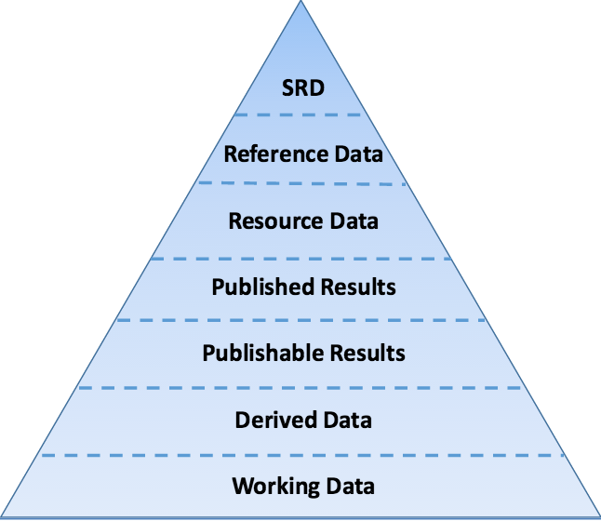
NIST Public Data Access Policy
data.gov
public
data

Slide 4
Data Categories
Working data: raw experimental data (instruments, simulations)
Derived data: working data that have been analyzed or processed
Publishable results: data ready for publication with uncertainty estimates, presented in SI units
Published results: reviewed by NIST and published in a journal, book, etc.
Resource data: data that support decisions or positions of NIST
Reference data: critically evaluated data
Standard reference data: critically evaluated data that are distributed under the terms of the SRD Act

Slide 5
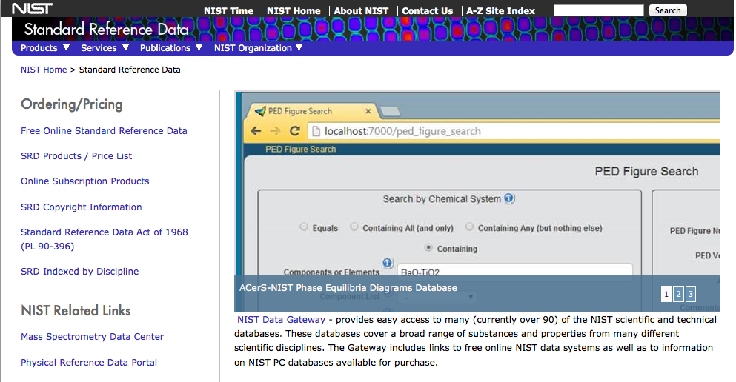
Standard Reference Data
SRD Act of 1968 authorized NIST to create Standard Reference Data
Copyright
Cost recovery
~100 databases, most are free to use

Slide 6
SRD Act 1968
Public law 90-396
“standard reference data” means quantitative information, related to a measurable physical or chemical property of a substance or system of substances of known composition and structure, which is critically evaluated as to its reliability
standard reference data …may be made available and sold… the prices established for such data may reflect the cost of collection, compilation, evaluation, publication, and dissemination of the data, including administrative expenses
the Secretary [of Commerce] may secure copyright and renewal thereof on behalf for the United States as author or proprietor in all or any part of any standard reference data
Budget of $1.86M was allocated for FY 1969

Slide 7
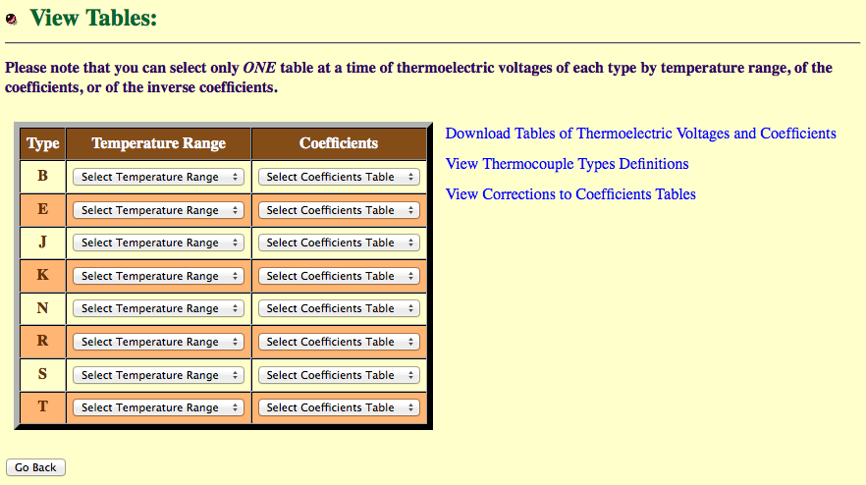
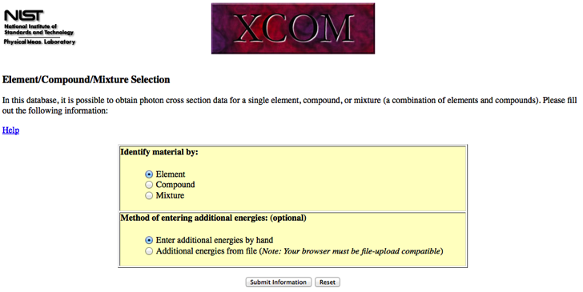
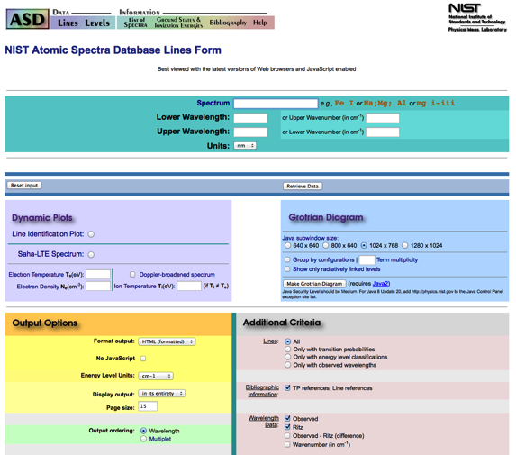
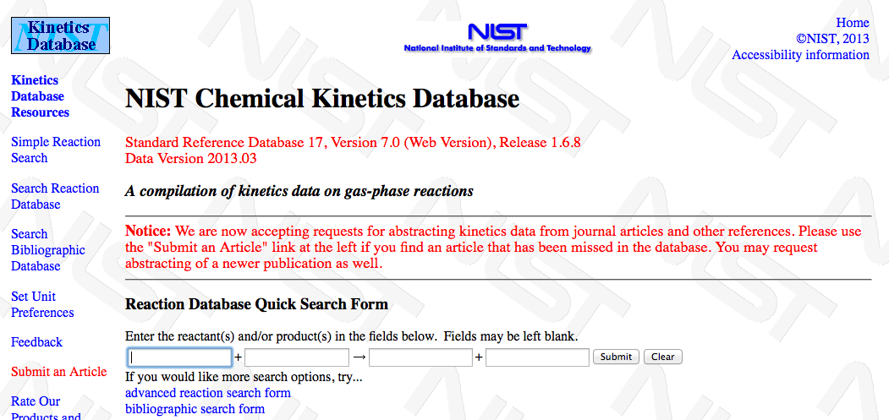
SRD Examples

Slide 8
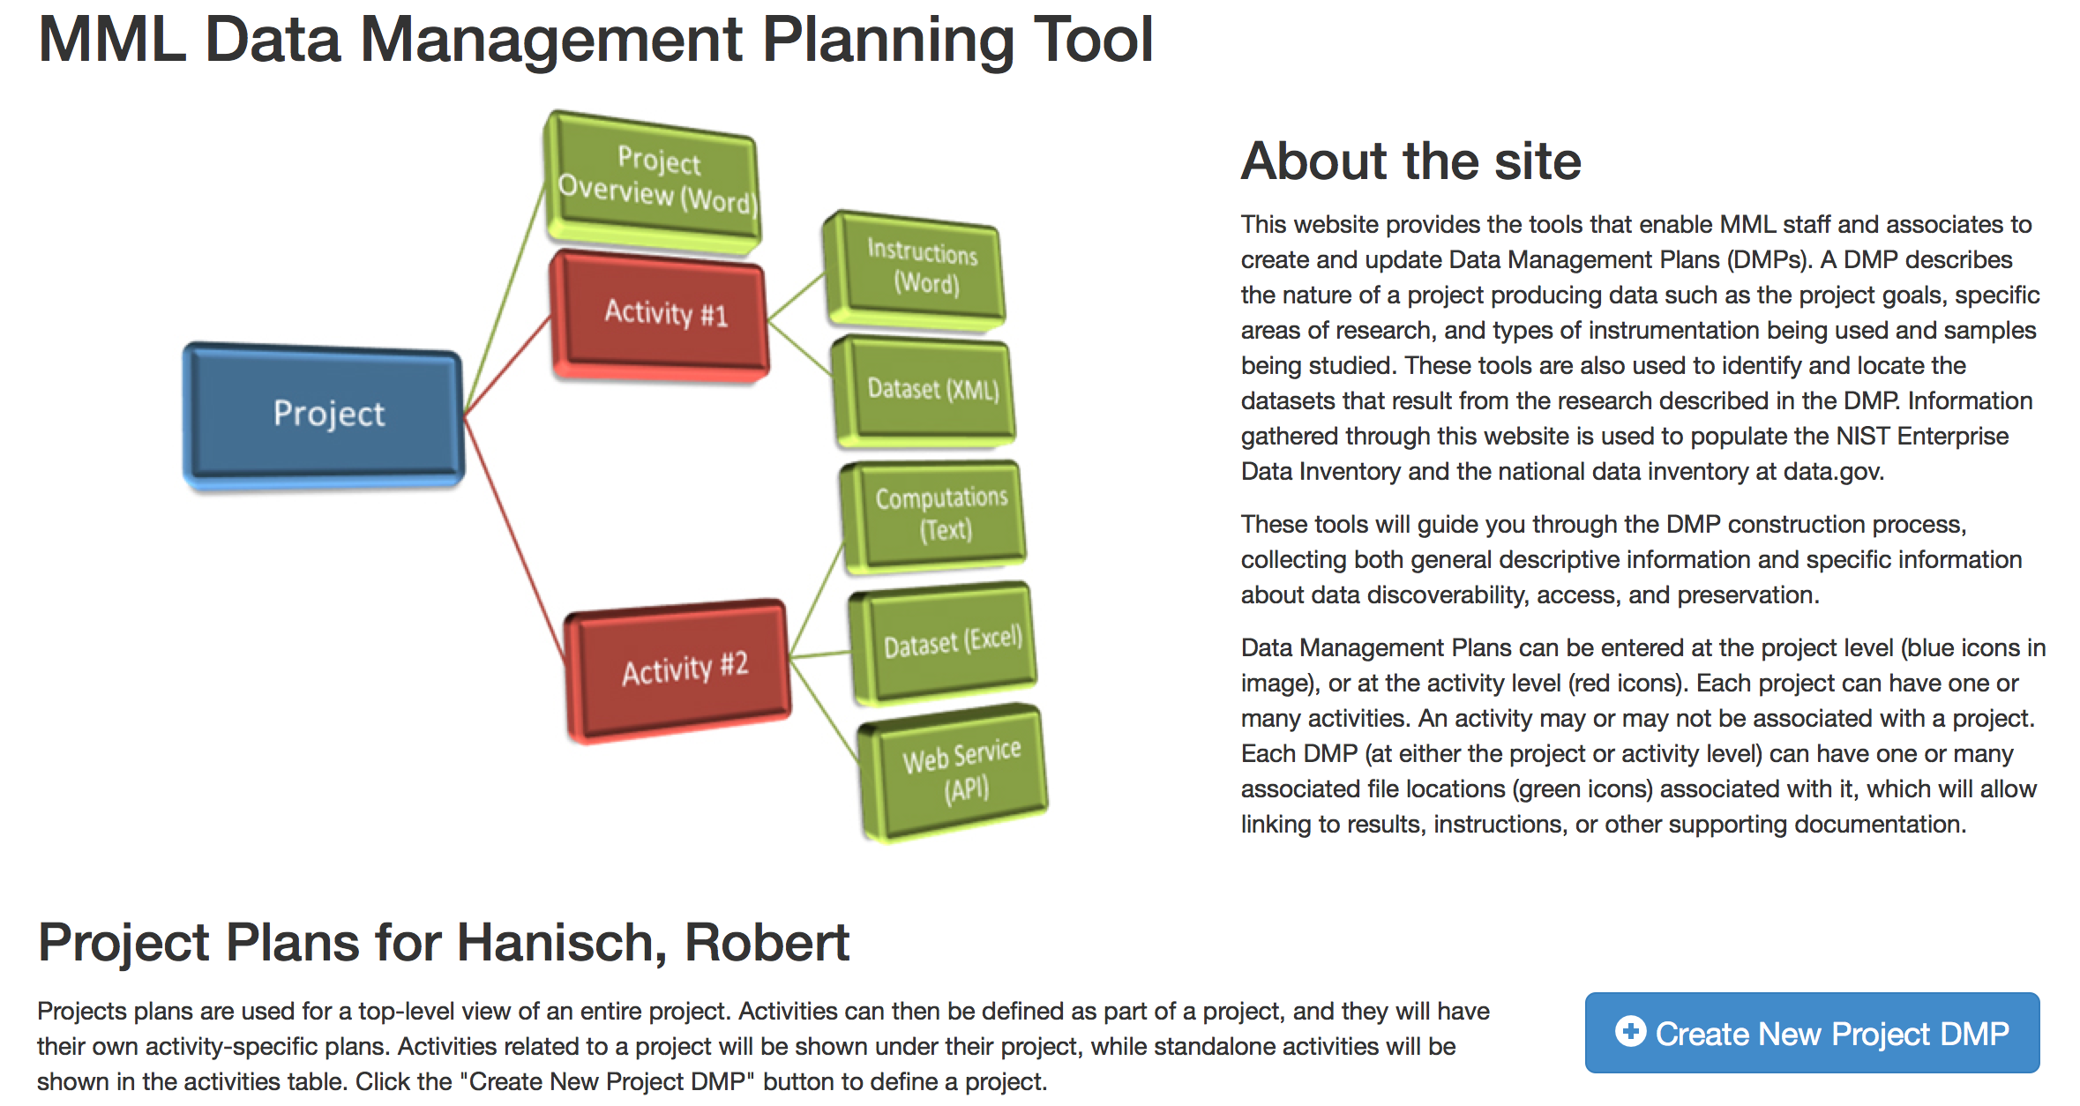
Implementation
Data management plans
Enterprise Data Inventory
data.gov

Slide 9
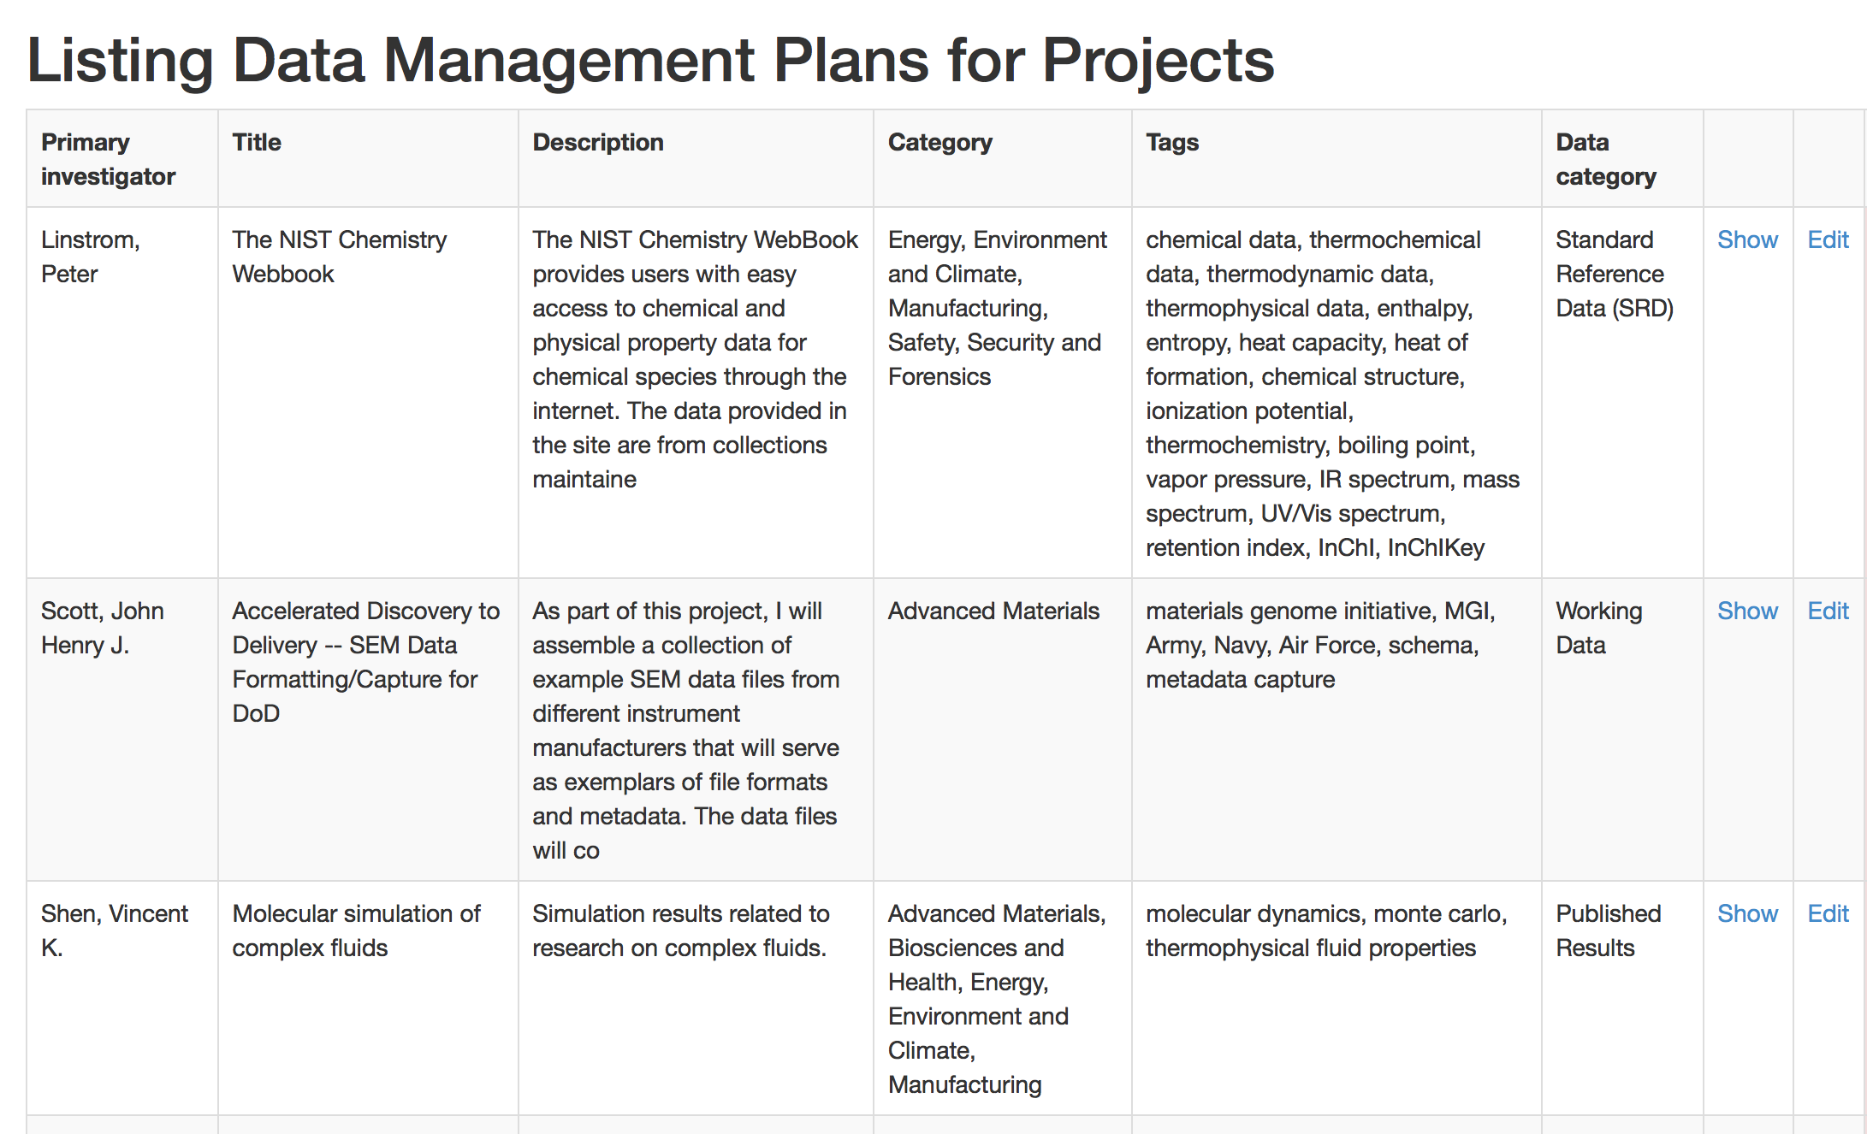
Data Management Plans

Slide 10
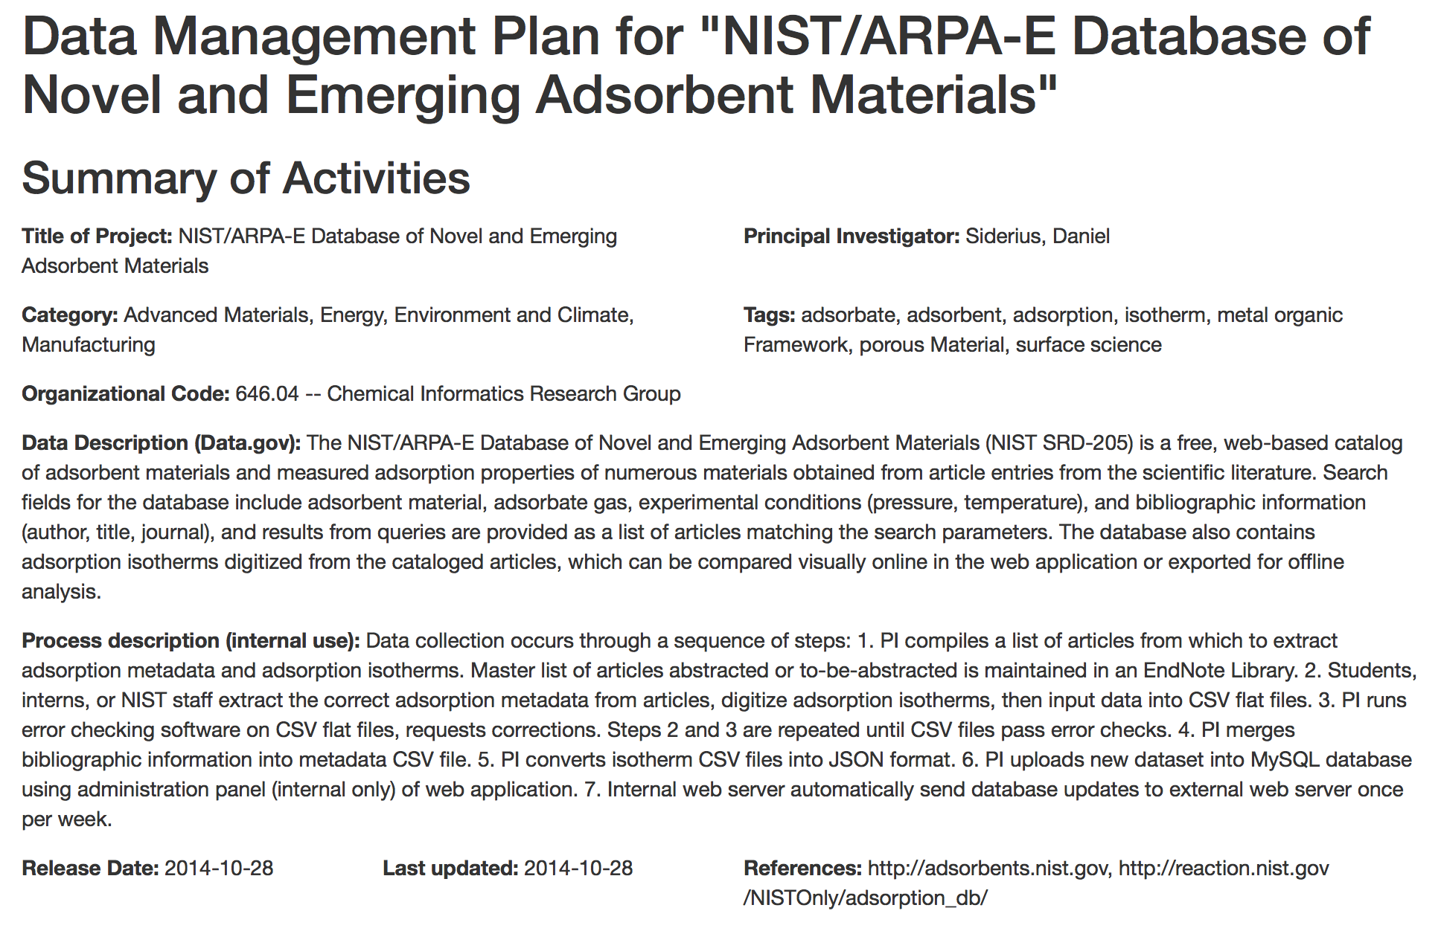
Data Management Plans

Slide 11
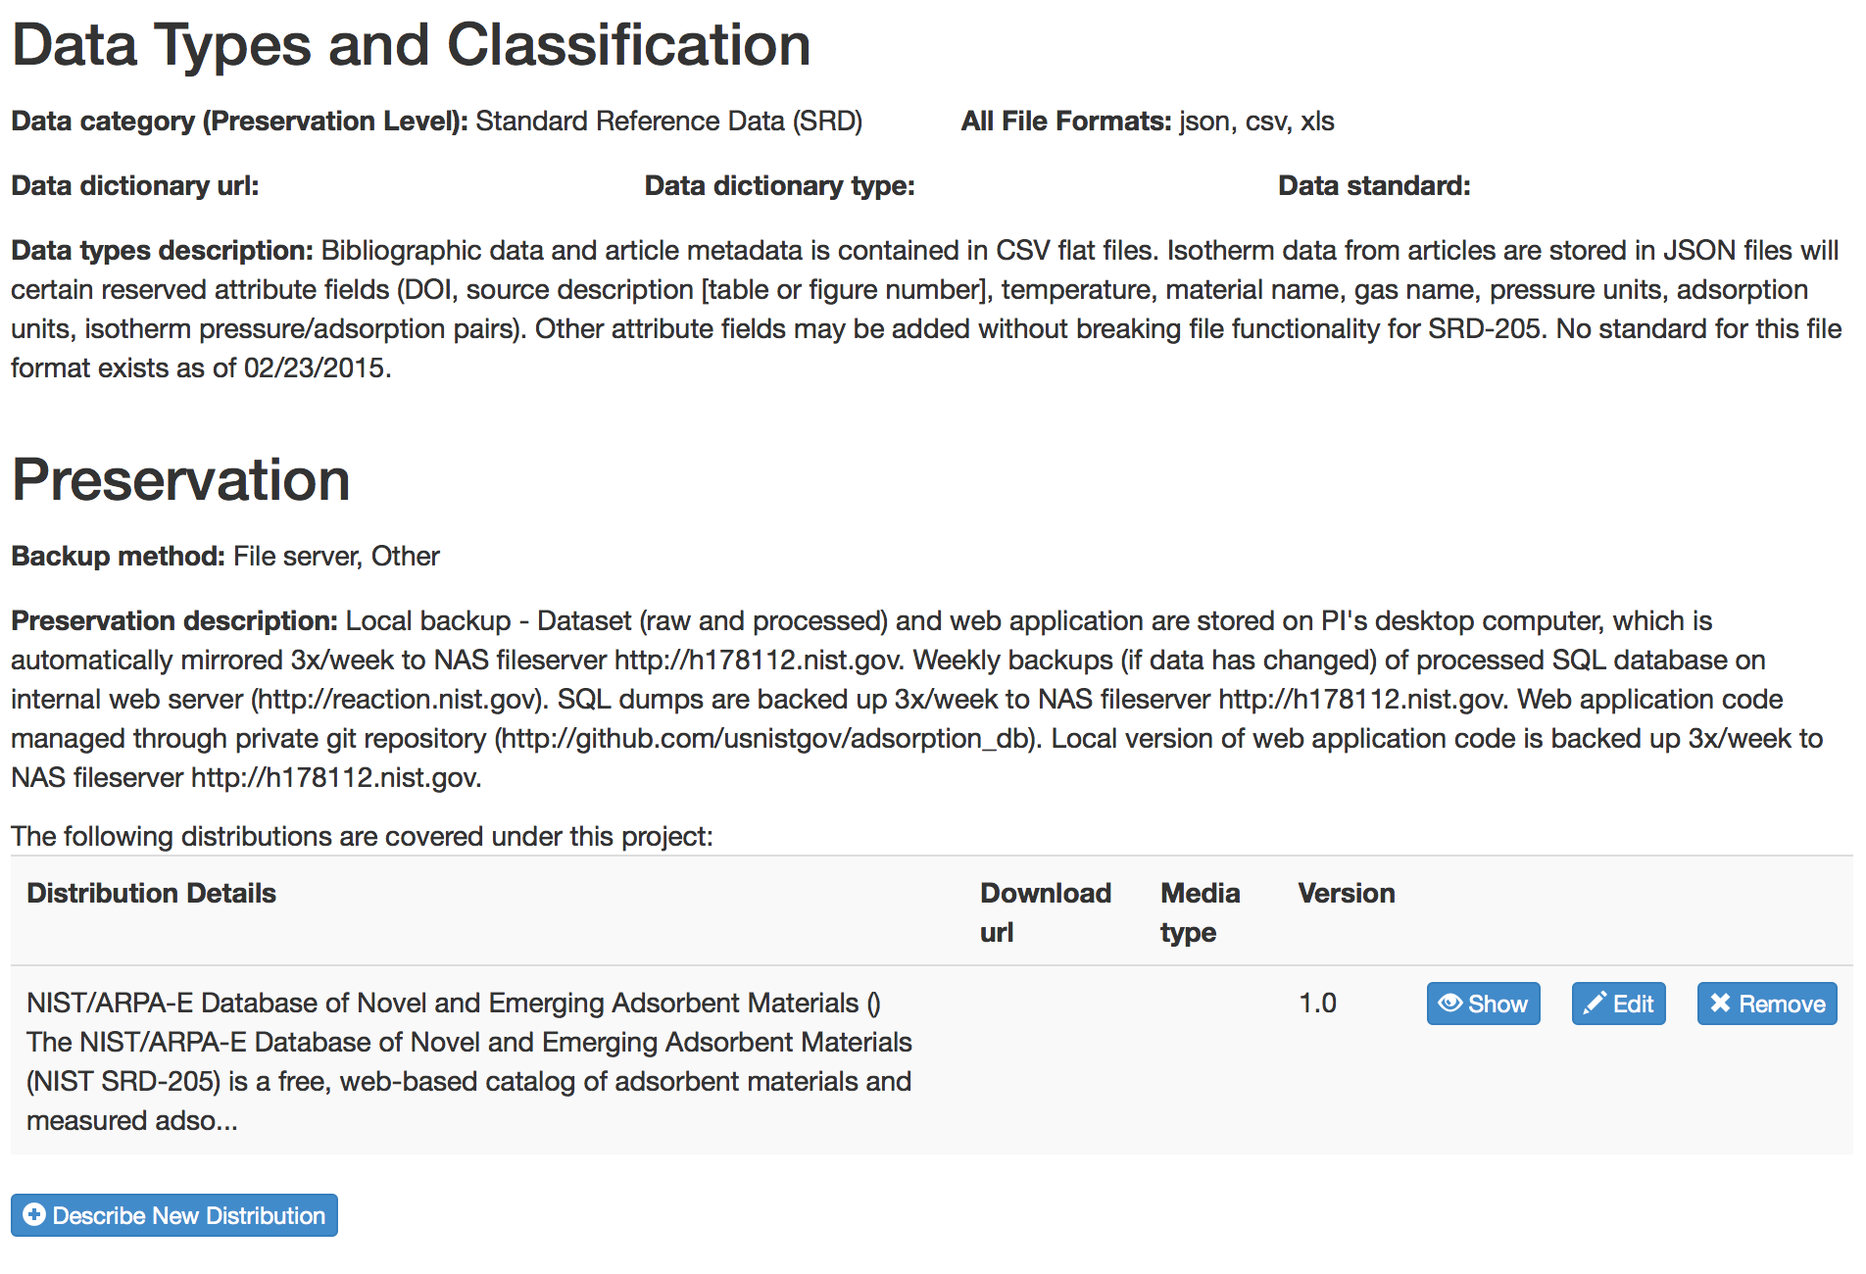
Data Management Plans

Slide 12
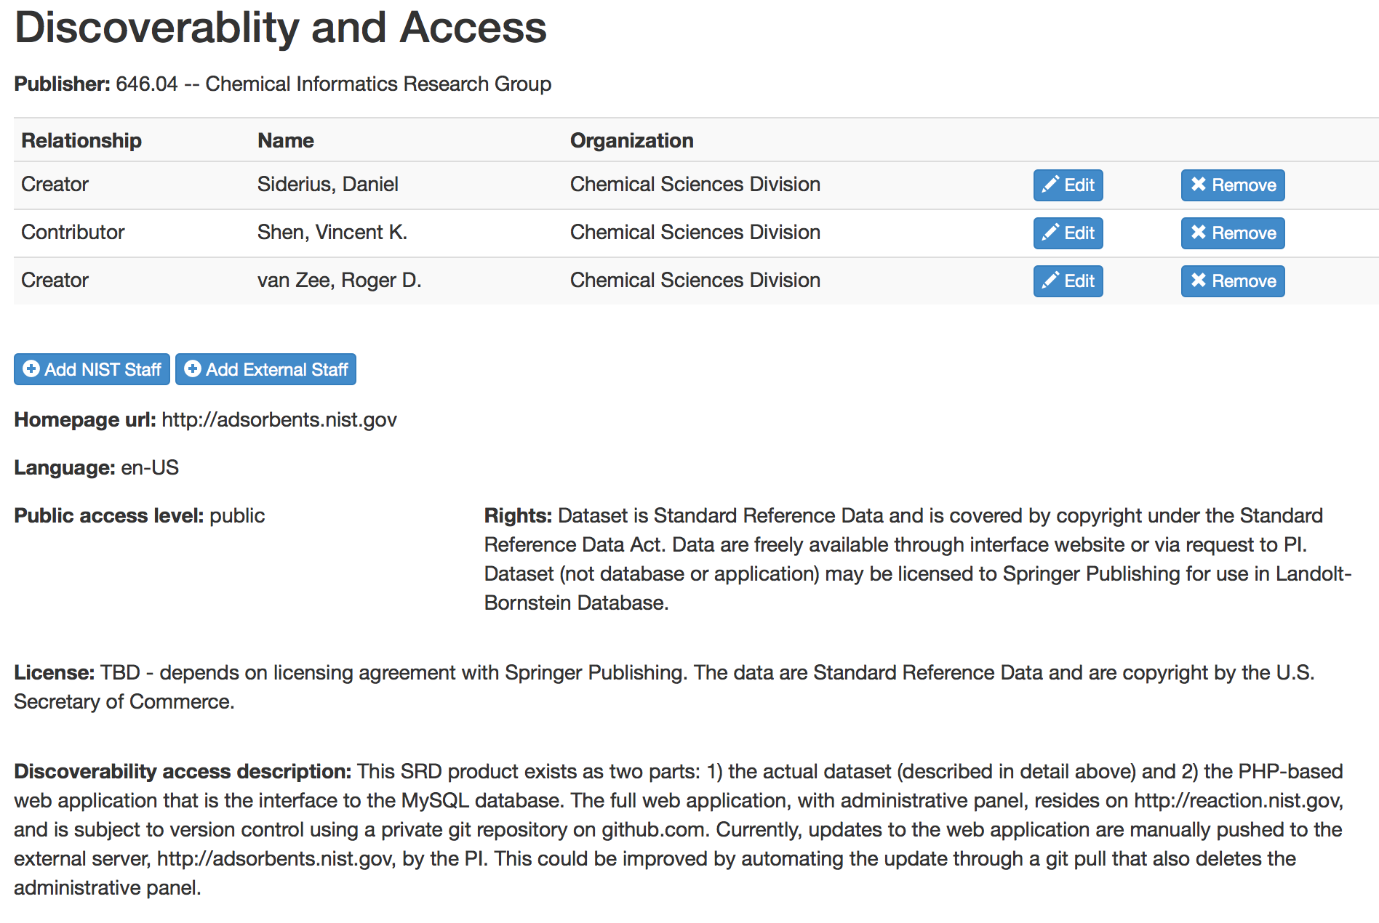
Data Management Plans

Slide 13
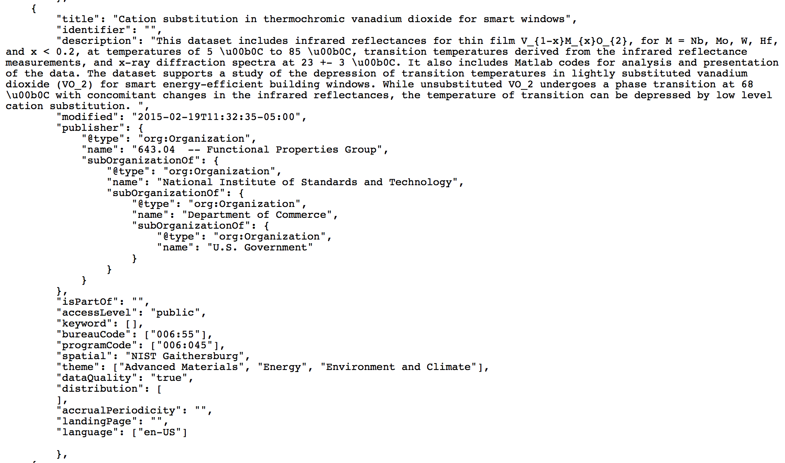
JSON Export to EDI, data.gov

Slide 14
Federated Architecture
Single
System
Image
NIST Data Management System
Data Management Plan (DMP)
Enterprise Data Inventory (EDI)
An integrated data planning tool that is extensible by all NIST organizations
A set of standards and minimum requirements for all NIST DMP applications.
An Integrated inventory, description, and locator of NIST open data.
A set of standards and minimum requirements for all NIST EDI applications.
Data.gov
DMP_{NIST}
EDI_{NIST}
DMP_{OU}
DMP_{n}
EDI_{OU}
EDI_{n}

Slide 15
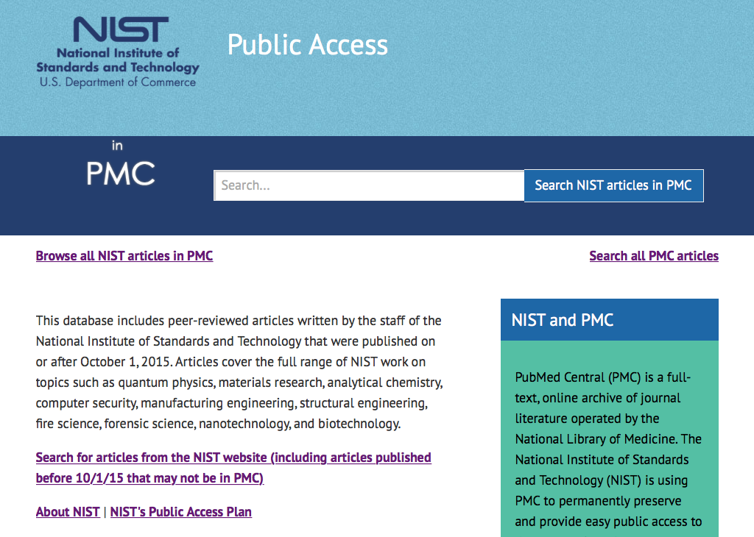
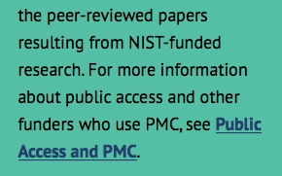
NIST Publications in PMC
NIST peer-reviewed papers published
on or after 1 October 2015 must be put
Into PMC within a year of publication.
Technical reports go to GPO FDsys.

Slide 16
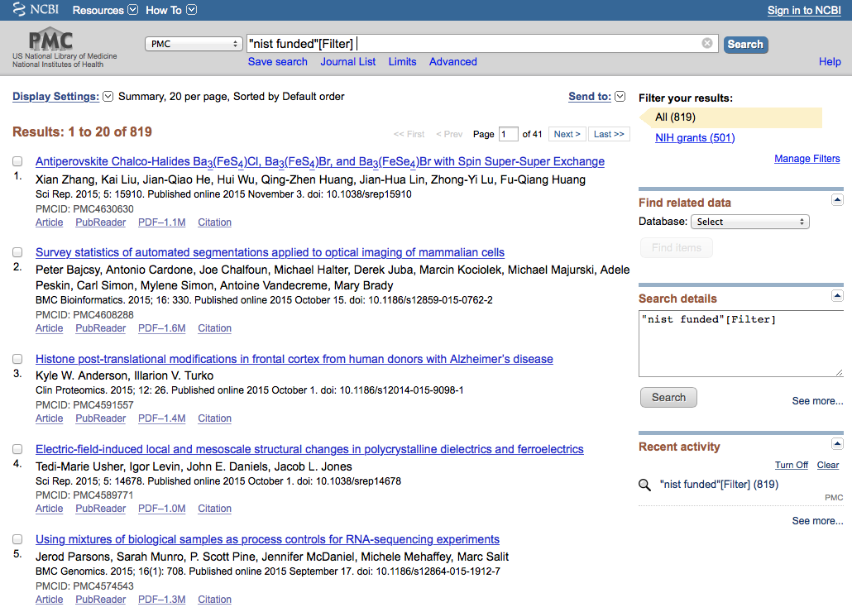
NIST Publications in PMC
NIST publications will be discoverable
through PMC, FDsys, CHORUS, nist.gov,
Google Scholar, and publisher websites

Slide 17
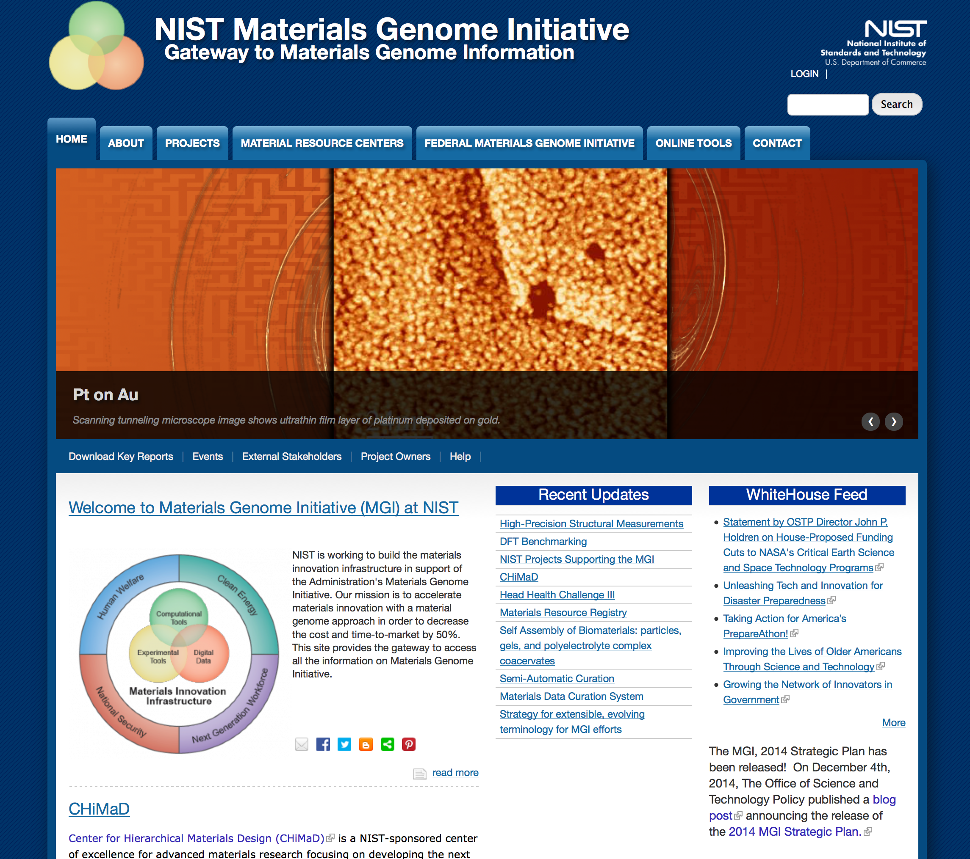
Materials Genome Initiative

Slide 18
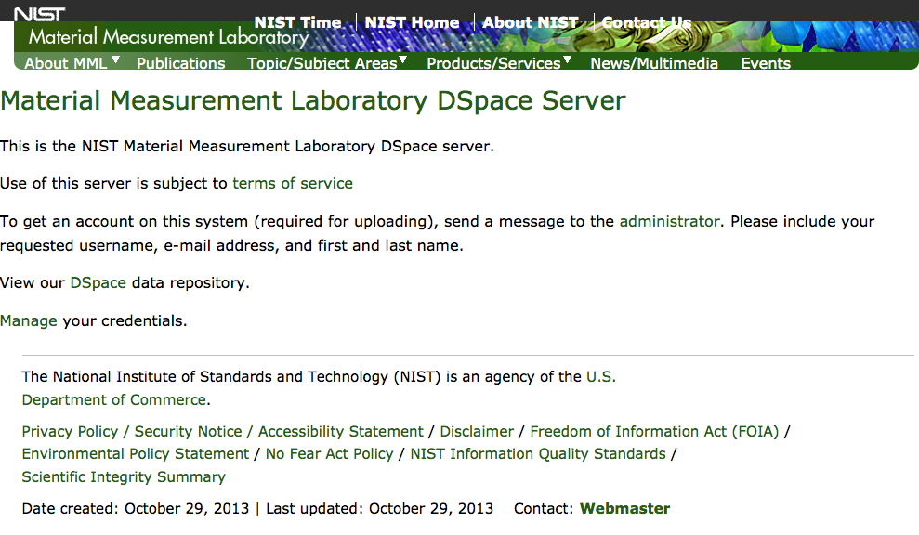
materialsdata.nist.gov

Slide 19
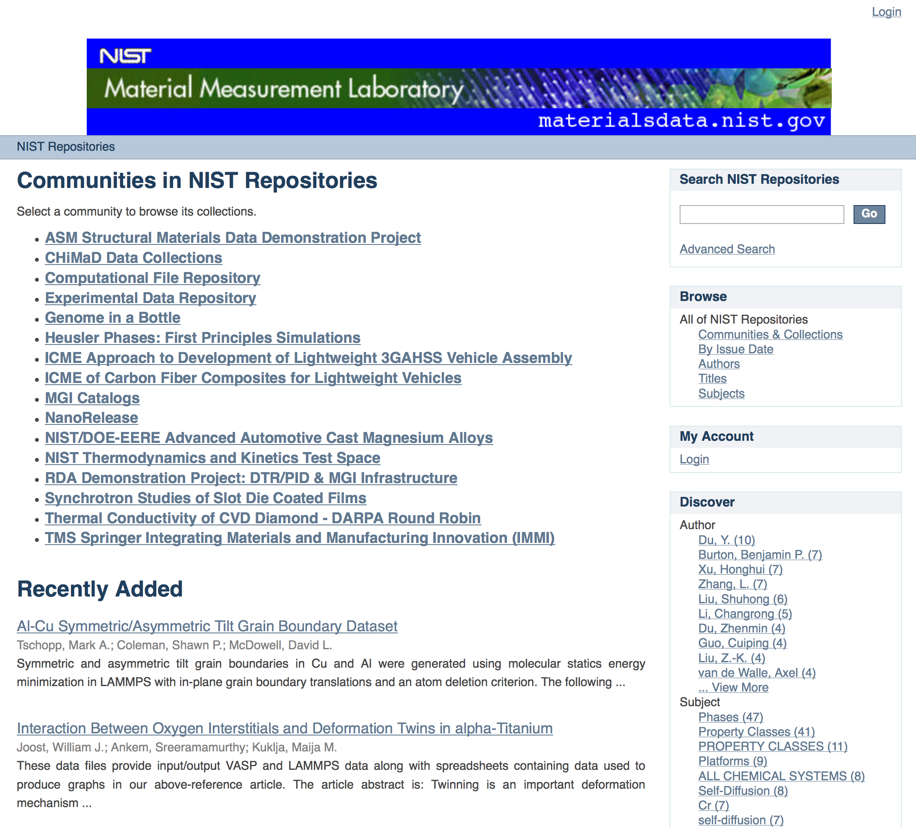
materialsdata.nist.gov

Slide 20
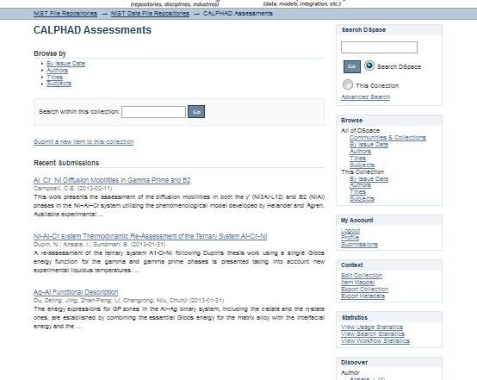
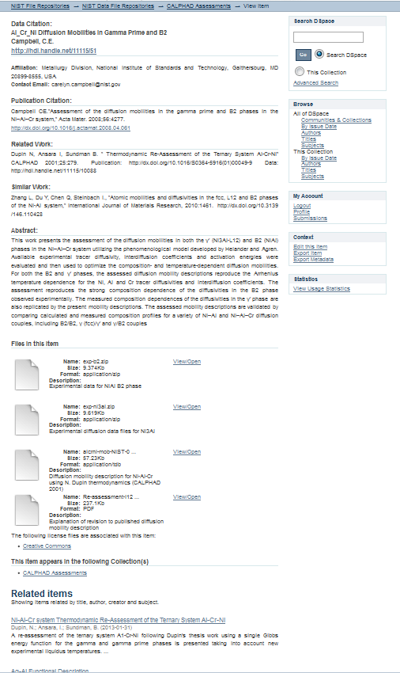

Sample Entry
Digital Identifier
Data files
Related Work
Similar Work
Offer licenses with attribution 3.0

Slide 21
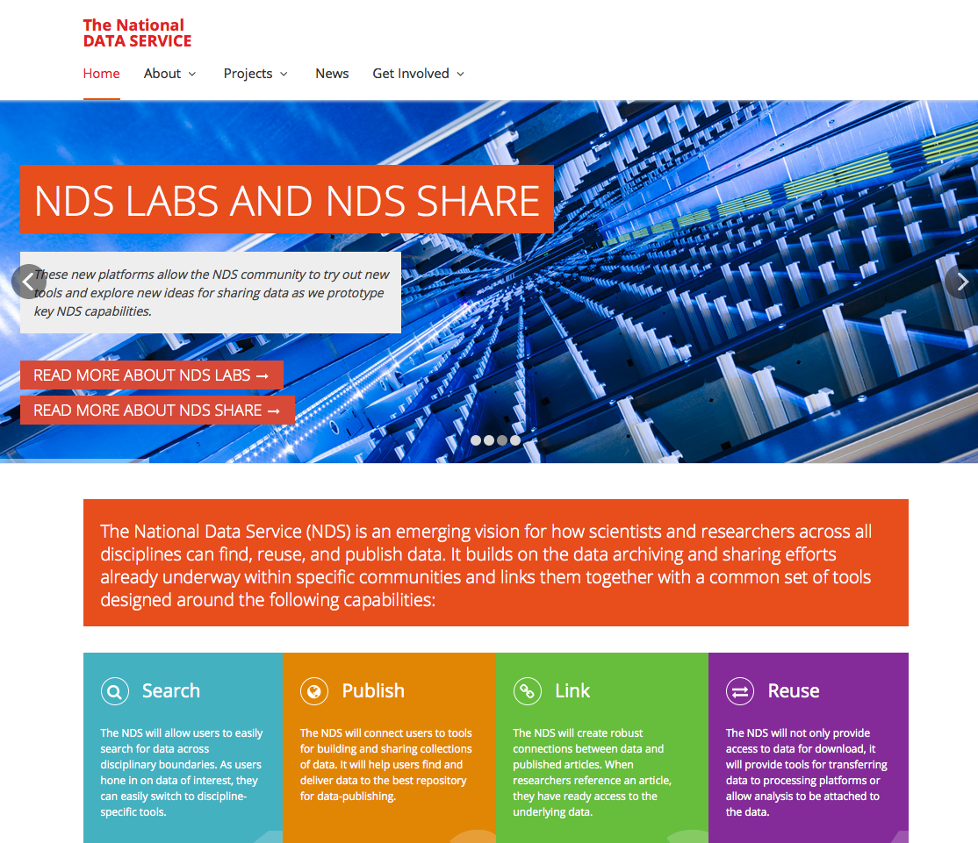
National Data Service
http://www.nationaldataservice.org/

Slide 22

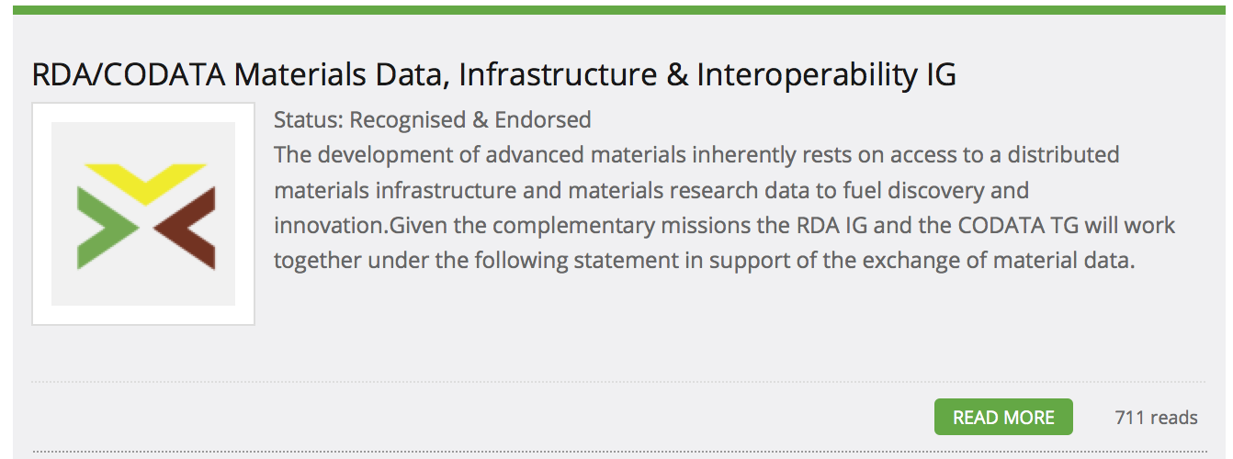
Research Data Alliance
http://rd-alliance.org/

